Slide 1
USER AUTHENTICATION SYSTEM WITH RC4 STREAM
ENCRYPTION
ALGORITHM
Karan Prabu Kandhaswamy
Abishek Lakshmirathan

Slide 2
Purpose & Scope
Software to view a specified file from the Database by the Authenticated user.
The software performs the authentication for the user to view the specified file as follows:
It allows the existing user to login to the application.
It allows registration for new users.
The software provides secure authentication to login application.
Networking Concepts used:
TCP/IP connection
Socket read and write

Slide 3
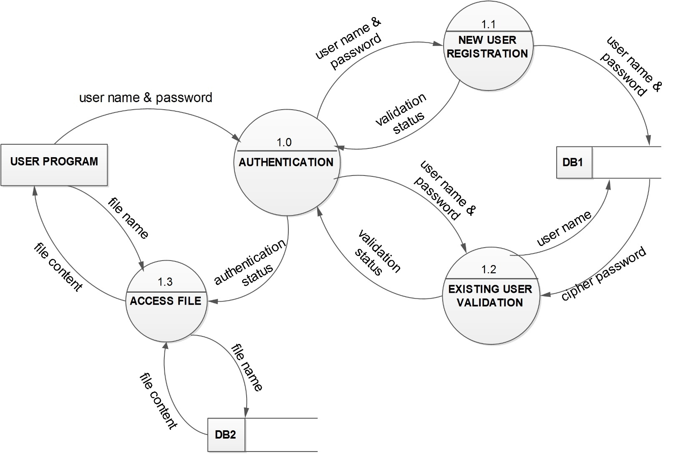
Design Level 1

Slide 4
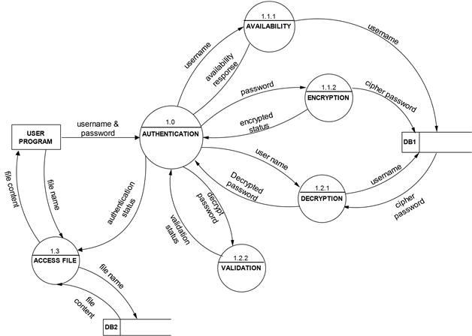
Design Level 2

Slide 5
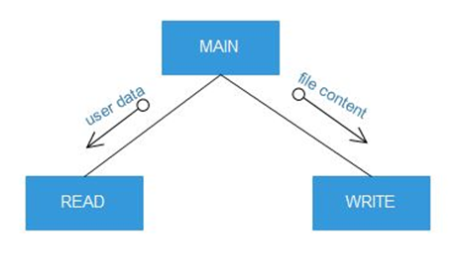
Structure Chart – Client Side

Slide 6
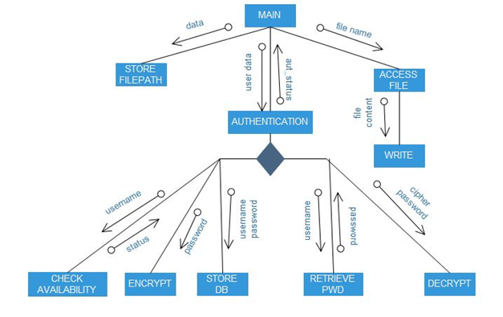
Server Side

Slide 7
Authentication- RC4 Encryption Algorithm
Developed by Ronald Rivest of RSA, is a shared key stream cipher algorithm requiring a secure exchange of a shared key.
Used identically for encryption and decryption such that the data stream is simply XORed with the generated key sequence
Used by
Wired Equivalent Privacy (WEP)
Wi-Fi Protected Access (WPA)

Slide 8
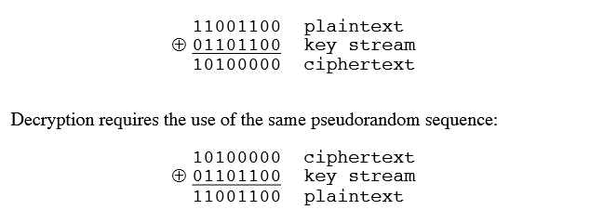
Example

Slide 9
Requirements
Software Requirements
Windows XP or windows 7
C compiler
Hardware Requirements
Intel Pentium processor or equivalent clone.
256 MB RAM
2 GB hard disk

Slide 10
References
KUMA97 Kumar, I. Cryptology. Laguna Hills, CA: Aegean Park Press, 1997.
MANT01 Mantin, I., Shamir, A. "A Practical Attack on Broadcast RC4." Proceedings, Fast Software Encryption, 2001.
RESC01 Rescorla, E. SSL and TLS: Designing and Building Secure Systems. Reading, MA: Addison-Wesley, 2001.
ROBS95 Robshaw, M. Stream Ciphers. RSA Laboratories Technical Report TR-701, July 1995. http://www.rsasecurity.com/rsalabs/index.html

